Slide 1

Practice #3: PyTorch Basics Basic Concepts, Tensors, Data processing, Autograd mechanics, Feed-forward NN
[SKT AI Course: Deep Learning Basics]
TA: Jun-Sik Choi & Jee-Seok Yoon
Instructor: Heung-Il Suk
hisuk@korea.ac.kr
http://www.ku-milab.org
Department of Brain and Cognitive Engineering,
Korea University
September 19, 2017

Slide 2
Contents
Basic Concepts (Pytorch Vs. Tensorflow)
Pytorch Tensors
Autograd mechanics
Data Loading and processing
Implement Feed-Forward Neural Network with Pytorch

Slide 3
Pytorch vs. Tensorflow

Slide 4
What is Pytorch?
Pytorch
python based deep learning library for researching and developing Deep learning models
origin from lua-based deep learning library, Torch.
Pytorch is written by native python language. (Not a simple set of wrapper to support Python)
Actively used at Facebook
essentially a GPU enabled version for NumPy with higher-level functionality for building and training deep neural networks.

Slide 5
What is Tensorflow?
Tensorflow
a Deep learning library for researching, developing, and distributing deep learning models.
developed by Google Brain and actively used at Google.
a programming language embedded within Python (Tensorflow codes are complied into a graph by Python and then run by the Tensorflow execution engine)

Slide 6
Difference - Adoption
Tensorflow
well documented
many users
many tutorials are available
hundreds of implemented and trained models on github
Pytorch
quickly getting its momentum
still in beta version (currently v. 0.2.0)
nice documentation and official tutorials
several computer vision architectures available

Slide 7
Difference – Graph definition
Both frameworks operate on tensors and view models as a directed acyclic graph(DAG).
They are different in a way to define DAGs.
Tensorflow
Use Static graph (Graph is defined before a model can run.)
All communication is performed via tf.session and tf.Placeholder
support limited dynamic inputs
Pytorch
Use Dynamic graph (Graphs can be defined, changed, and executed as model runs)
Being tightly integrated with Python language, give more native and free way to work with models.
Dynamic neural net like RNNs can benefit from this dynamic approach

Slide 8
Difference – Data loading
Tensorflow
relatively not intuitive for data loading.
adding preprocessing code in parallel into Tensorflow graph is not straight-forward.
Pytorch
APIs for data loading are well designed.
a data loader takes a dataset and produces an iterator over the dataset.
Parallelizing data loading is simple.

Slide 9
Difference – Debugging
Tensorflow
Need to use a special debugging tool, tfdbg
tfdbg allows to evaluate tensorflow expressions at runtime and browse all tensors and operations in session scope.
Pytorch
Graph is defined at runtime
You can use your favorite Python debugging tools such as pdb, ipdb, Pycharm debuggers.

Slide 10
Difference – Visualization
Tensorflow
has its own visualization tool Tensorboard.
Tensorboard can
display model graph
plot scalar variables
visualize distributions and histograms
visualize images
visualize embeddings
play audio
Pytorch
Currently, no equivalent for Tensorboard.
Integrations to tensorboard exist
standard plotting tools (matplotlib, seaborn) can be used

Slide 11
Difference – Serialization
Both frameworks provides simple way to saving and loading models
Tensorflow
Tf.Saver object provides easy way to save models and check-points.
Entire graph can be saved as a protocol buffer.
Graph can be loaded in other supported languages (C++, JAVA)
Pytorch
provides simple API that can save all the weights of a model.

Slide 12
Difference – Custom extensions
Building or binding custom extensions written in C, C++ or CUDA is doable in both frameworks
Pytorch
You can make extensions by simply write an interface and correponding implementation for each of the CPU and GPU versions.
Tensorflow
requires more boilerplate code for custom extensions.

Slide 13
Difference – Deployment
Tensorflow
Tensorflow Serving provides a easy way to deploy models
models can be deployed into embeded system or mobile platforms.
Provide high performance server-side deployments
support Distributed training
Pytorch
For a small-scale server-side deployments are easy to wrap using Flask web server.
support Distributed training

Slide 14
Summary
Both frameworks provides useful abstractions to reduce repeated codes and speed up the model development.
PyTorch
provides flexible dynamic graph definition
more 'pythonic' way for developing and debugging
an object-oriented approach.
PyTorch is better for rapid prototyping in research, and small scale projects.
Tensorflow
provide great visualization and deployment tools.
A good choice if you develop a model for production and deploying on mobile platforms
Tensorflow is better for large-scale deployments especially when cross-platform and embedded deployment is a consideration

Slide 15
PyTorch Tensor

Slide 16
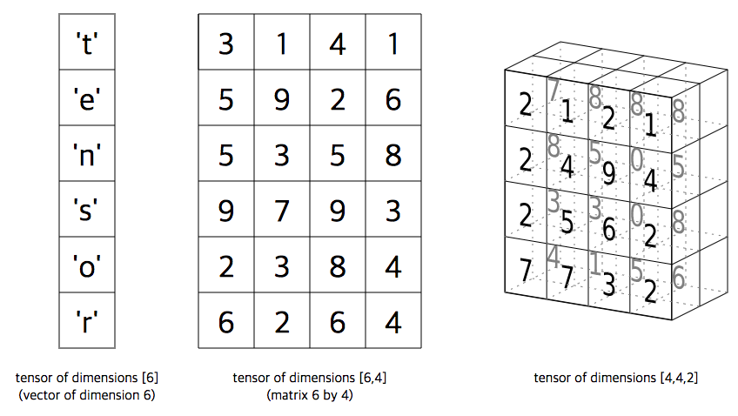
Tensor
torch.Tensor
a multi-dimensional matrix containing elements of a single data.
similar to numpy’s ndarray, except torch.Tensors can also be used on a GPU to accelerate computing.

Slide 17
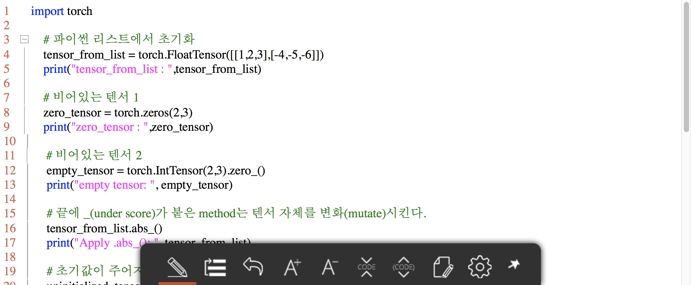
Create Tensor
Pytorch provides various ways to create Tensors (from list, ndarray,…)

Slide 18
Task #1
Uncomment examples_create_tensor(), run it, and observe the results
Refer to http://pytorch.org/docs/master/torch.html?highlight=tensor#creation-ops and Create Torch.Tensor in various way by yourself.
Check the GPU is available by torch.cuda.is_available() and if available, move tensors to GPU by .cuda() method.

Slide 19
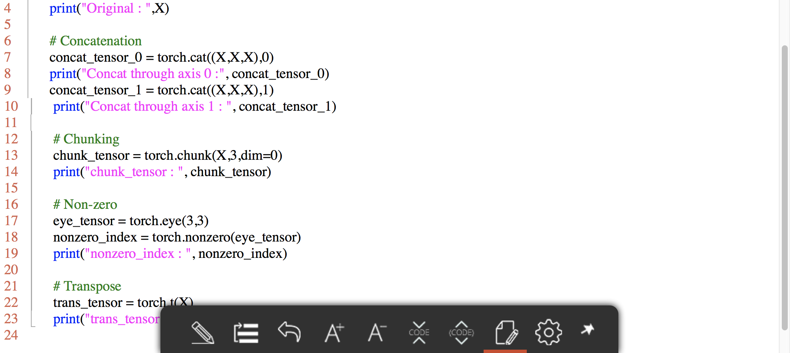
Manipulate Tensor

Slide 20
Task #2
Uncomment examples_manipulate_tensor(), run it, and observe the results
Refer to http://pytorch.org/docs/master/torch.html?highlight=tensor#creation-ops and Create Torch.Tensor in various way by yourself.

Slide 21
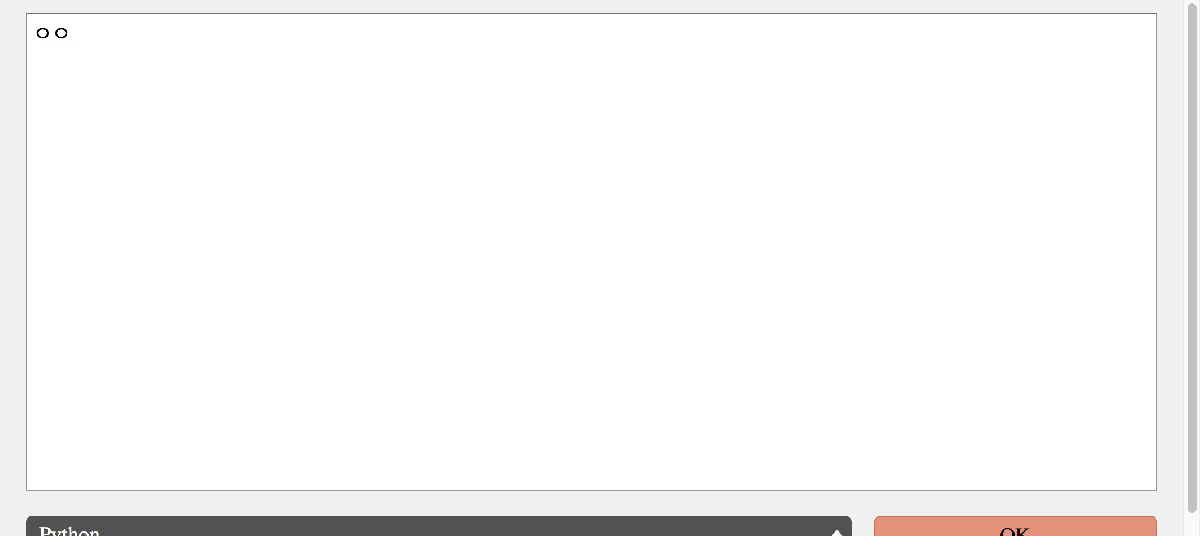
Tensor operation

Slide 22
Task #3
Uncomment examples_manipulate_tensor(), run it, and observe the results
Refer to http://pytorch.org/docs/master/torch.html?highlight=tensor#creation-ops and Create Torch.Tensor in various way by yourself.

Slide 23
Data Loading and Processing

Slide 24
Pytorch Autograd mechanics

Slide 25
Implement Feed-Forward Neural Network with Pytorch

Slide 26
Reference
[1] https://medium.com/towards-data-science/pytorch-vs-tensorflow-spotting-the-difference-25c75777377b
[2] https://awni.github.io/pytorch-tensorflow/?imm_mid=0f5a8c&cmp=em-data-na-na-newsltr_ai_20170828

Slide 27
Thank you
For your attention!!!
(Q & A)
hisuk (AT) korea.ac.kr
http://www.ku-milab.org

